Slide 1
From reactive to proactive: the metamorphosis of antiviruses
Radosław Kumorek
SFI 2024

Slide 2
anegdota

Slide 3
Statisctics
new viruses detected per day
560 000
Existing malwares
1 000 000 000

Slide 4
History
1966
Theoretical malware by John von Neumann
1966
Creeper worm by Bob Thomas (not malicious)
1966
Elk Cloner virus by Rick Skrenta

Slide 5
Malware
Trojan
Ransomware
MALWARE (MALICIOUS SOFTWARE)
Spyware
Adware
Rootkit
Keylogger
Bots

Slide 6

Black hat
Blackhat – computer hacker who violates laws

Slide 7
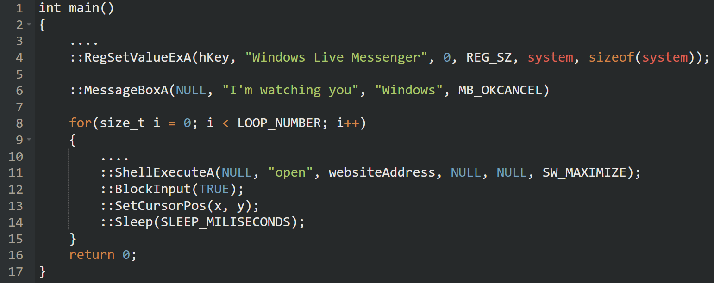
Wacatac

Slide 8
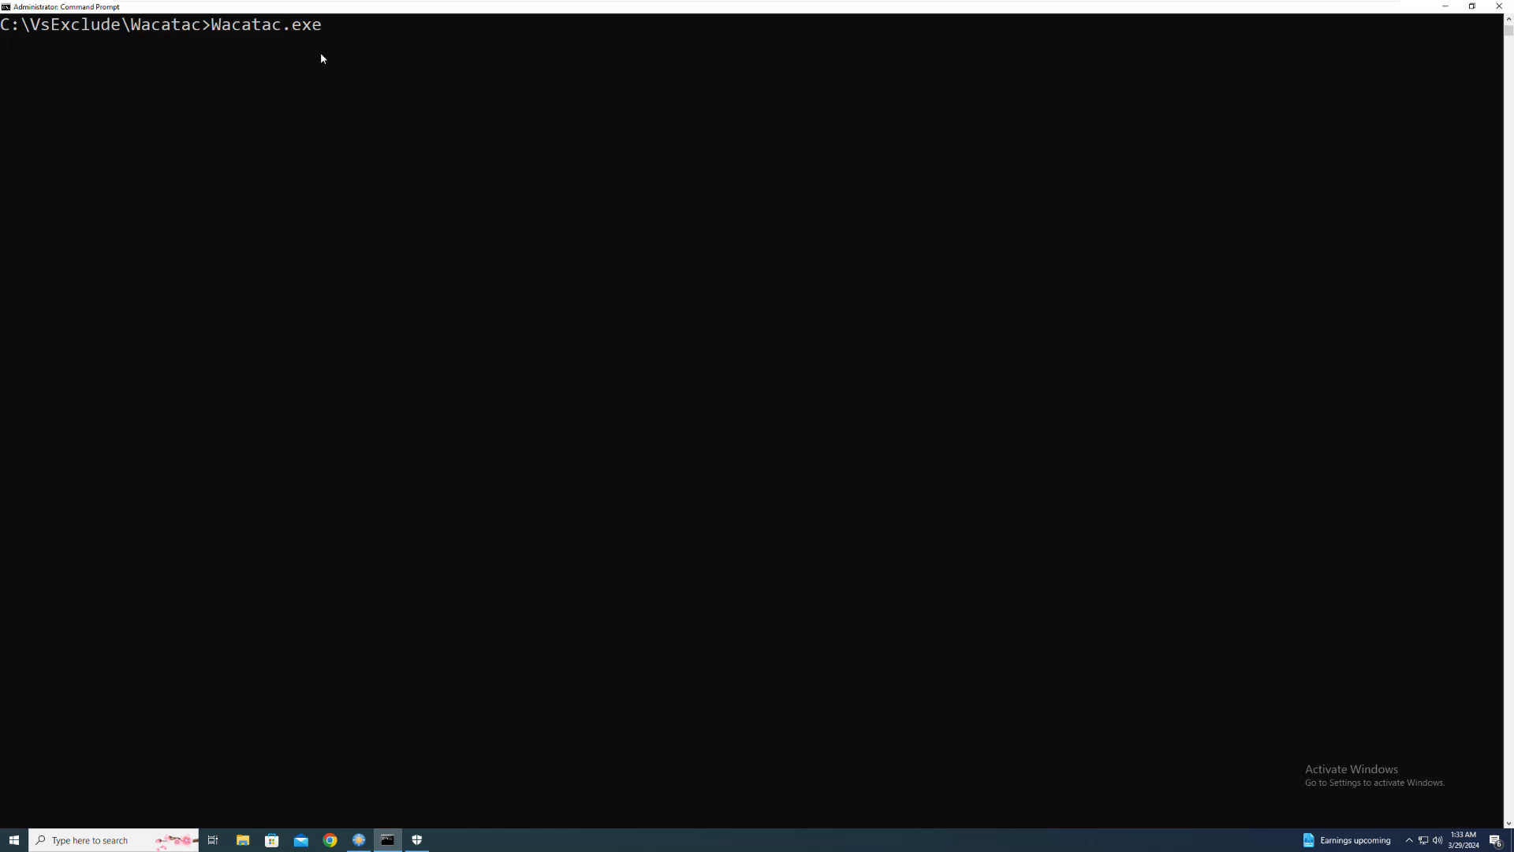
Wacatac

Slide 9


STATIC ANALYSIS
Types of detection/analysis
Static analysis in cybersecurity
Static analysis in car mechanics
scanning a file before launch
Checking the car before starting the engine

Slide 10

STATIC ANALYSIS
Simplest detection
Malwares database
File
Is the file in the database?

Slide 11

STATIC ANALYSIS
Comparing files
Compare files byte by byte? low efficiency
Compare sizes? not deterministic

Slide 12
STATIC ANALYSIS
Hash function
FILE
SHA256
CHECKSUM

Slide 13
STATIC ANALYSIS
Hash function
notepad.exe
SHA256
87F53BC444C05230CE439DBB127C03F2E374067D6FB08E91C834371FD9ECF661

Slide 14
STATIC ANALYSIS
Simplest detection
Malwares SHA database
File
SHA256
Is SHA in the database?
Checksum

Slide 15
STATIC ANALYSIS
Algorithm

Slide 16
STATIC ANALYSIS
Wacatac_sha.sig
name: Watacat.exe
description: <malware description>
sha256:9CB63AE435458E97697A04255DD0655724E89F98026FED152EE1D36F8CA5EB0E

Slide 17
STATIC ANALYSIS
Example

Slide 18
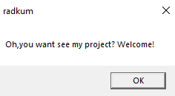
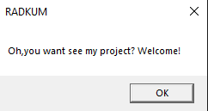
STATIC ANALYSIS
Evading
Wacatac_v1.exe
Wacatac_v2.exe
9CB63AE435458E97697A04255DD0655724E89F98026FED152EE1D36F8CA5EB0E
B43043CFC7B24FBABE9CB37634F081370CF25878D0054FB9578128F3895ED82F

Slide 19
STATIC ANALYSIS
Malwares similarities
RESOURCES
IMPORTS
STRINGS

Slide 20
STATIC ANALYSIS
Wacatac_heur.sig
name: Watacat.exe
description: <malware description>
calls: [Sleep, BlockInput, SetCursorPos, ShellExecuteW, MessageBoxW, RegSetValueExW]

Slide 21
STATIC ANALYSIS
Example
Imports
Resources
Strings

Slide 22
STATIC ANALYSIS
False positives
 | Antyvirus detection | No detection
It’s malware | TRUE POSITIVE (malware correctly detected) | FALSE NEGATIVE (malware not detected)
Clean file | FALSE POSITIVE (clean file improperly detected) | TRUE NEGATIVE (clean file correctly not detected)

Slide 23

STATIC ANALYSIS
Archives
Typical archives
ZIP
TAR
RAR
Files which store objects
DOCX
APK
MSI
Self extracting (SFX)
UPX

Slide 24
STATIC ANALYSIS
Algorithm
Imports
Resources
Strings

Slide 25
STATIC ANALYSIS
Example
Imports
Resources
Strings

Slide 26
DYNAMIC ANALYSIS
Types of detection/analysis
Dynamic analysis in cybersecurity
Dynamic analysis in car mechanics
run file in „safe” environment
Start engine remotely on desert

Slide 27
DYNAMIC ANALYSIS
Obfuscation
Encrypted strings
Lazy loading of libraries
run file in „safe” environment
Start engine remotely on desert

Slide 28
DYNAMIC ANALYSIS
Wacatac
Encrypted strings
Lazy loading of libraries
run file in „safe” environment
Start engine remotely on desert

Slide 29

DYNAMIC ANALYSIS
Sandbox
ISOLATED ENVIRONMENT
FAKENET
filestytes
VIRTUALIZATION

Slide 30

DYNAMIC ANALYSIS
Quasi-Sandbox
NORMAL
HOOKED
API CALL
API CALL
MY FUNCTION
API FUNCTION
API FUNCTION

Slide 31
DYNAMIC ANALYSIS
Algorithm

Slide 32
DYNAMIC ANALYSIS
Wacatac_dyn.sig
name: Watacat.exe
description: <malware description>
calls: [Sleep, BlockInput, SetCursorPos, ShellExecuteW, MessageBoxW, RegSetValueExW]

Slide 33
DYNAMIC ANALYSIS
Example

Slide 34
DYNAMIC ANALYSIS
Antyvirtualization Tricks

Slide 35
BEHAVIOURAL ANALYSIS
Types of detection/analysis
Behavioural analysis in cybersecurity
Behavioural analysis in car mechanics
Process started normally, but we still monitor its behaviour
we start driving, but we keep the warning lights in mind

Slide 36
BEHAVIOURAL ANALYSIS
Information flow

Slide 37
BEHAVIOURAL ANALYSIS
Algorithm

Slide 38
BEHAVIOURAL ANALYSIS
Wacatac_beh.sig
name: Watacat.exe
description: <malware description>
event_type: RegSetValue
attributes:
value_name: Windows Live Messenger
key_name: \HKEY_LOCAL_MACHINE\SOFTWARE\Microsoft\Windows\CurrentVersion\Run
data: C:\WINDOWS\system32\evil.exe

Slide 39
BEHAVIOURAL ANALYSIS
Example

Slide 40
Types of detection - summary

Slide 41
Other modules

Slide 42
EDR

Slide 43
XDR

Slide 44
Is it worth it?

Slide 45
Thanks
Source: https://github.com/radkum

